Slide 1


HR BUSINESS CASE
USING DATA ANALYTICS TO IMPLEMENT IMPACTFUL PEOPLE INITIATIVES
Fco. Javier Sanchez

Slide 2
INTRODUCTION
WE ARE AN EXTERNAL HR & WELLBEING CONSULTING COMPANY
WE are SUPPORTING +1600 REMOTE employees across 7 SUBSIDIARIES AND 5 COUNTRIES – GROUP PART AS A JOINT VENTURE 7 years AGO
WORKING ON THE PROFESIONALIZATION OF THE HR DEPARMENT
WHO ARE WE?

Slide 3
WHAT CHALLENGES ARE WE FACING?
No PROPER EMPLOYEE DATABASE OR FULL VISIBILITY OVER the WHOLE COMPANY STRUCTURE AT A GLANCE AND NO HISTORICAL DATA
NO VISIBILITY OVER COST OR The Implications OF ABSENTEISM
HR KPI’s NOT ALIGNED ACROSS THE ORGANISATION AND ONLY SOME OF THEM MONITORED (ON GOOGLE SHEETS)

Slide 4
WHAT IS THE SCOPE OF THIS PROJECT?
TO CREATE AN EMPLOYEE DATABASE USING MYSQL, WHICH WILL BE USED AS BASELINE FOR FUTURE DATA COLLECTION
1
DATA ANALYSIS & EMPLOYEE CLUSTER IDENTIFICATION
3
TO PROPOSE WELLBEING INITIATIVES BASED ON DATA TO REDUCE ABSENTEEISM
4
TO DEFINE AND CREATE HR KPIs AND DASHBOARDS TO UNDERSTAND WERE WE ARE – FOCUS ON ABSENTEEISM
2

Slide 5
PROJECT KEY INFORMATION
HR DATA AVAILABLE : Current employee demographic and employment data, financial costs, sick leave data based on historical precedents
ABSENTEEISM – (SICK + UNJUSTIFIED LEAVE) / WORKING DAYS
Healthy rate: 1,5% to 2% according to industry standards (CIPD), absenteeism in the EU ranges from: 3% to 6%
EMPLOYEE CLUSTERS : Employees who share similar characteristics (demographic, hierarchical…)

Slide 6
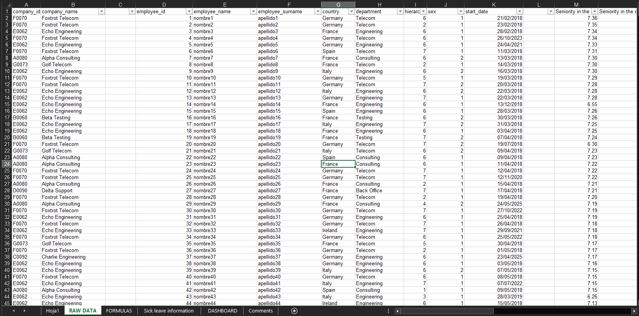
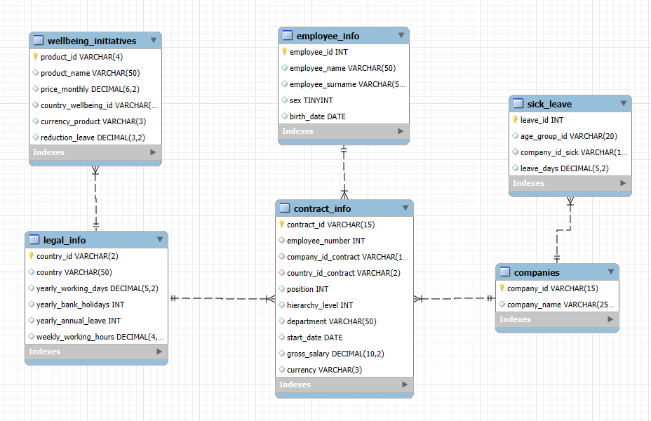
OBJECTIVE 1: Unify and create employee database using MySQL
7 different Google sheets files/
Database in MySql

Slide 7
OBJECTIVE 2: HR KPI’S & Dashboards
GLOBAL HR DASHBOARD
HR HEADCOUNT & DEMOGRAFICS DASHBOARD
ABSENTEEISM & FINANCIAL DASHBOARD
OTHER DASHBOARDS (NOT IN THE SCOPE – TO BE ADDED IN THE FUTURE)
PAYROLL DASHBOARD
PERFORMANCE & USER DASHBOARD
RECRUITMENT & TALENT

Slide 8
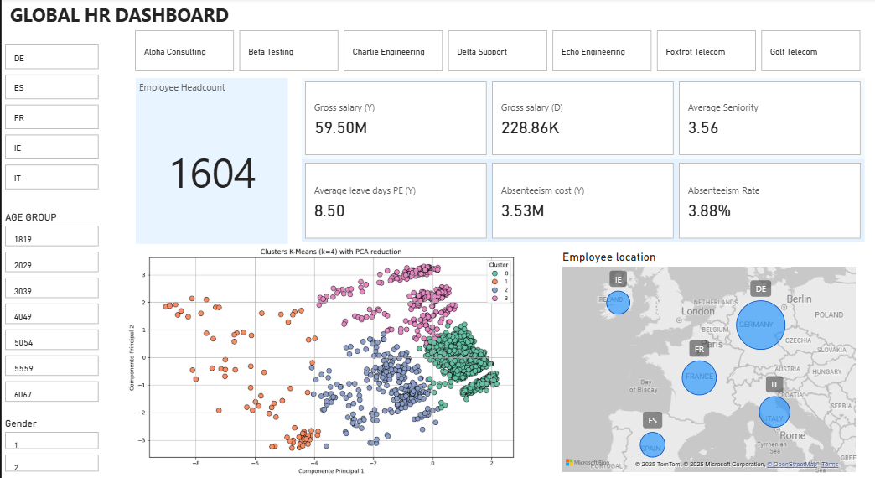
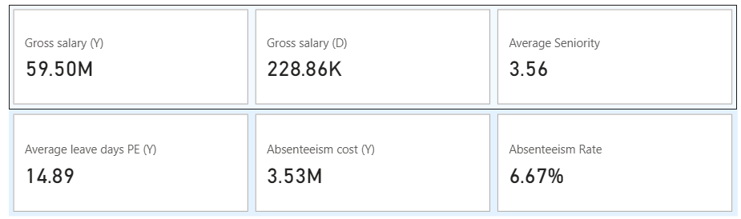
OBJECTIVE 2: Global HR Dashboard

Slide 9
OBJECTIVE 2:
KEY TAKEAWAYS FROM THE HR GLOBAL DASHBOARD
Germany (DE) is the primary workforce hub, with the largest employee population, followed by France (FR) and Spain (ES).
The 2 Absenteeism KPI´s are higher than the median of the EU . this highlights the financial impact of time off and the need of managing absenteeism proactively.

Slide 10
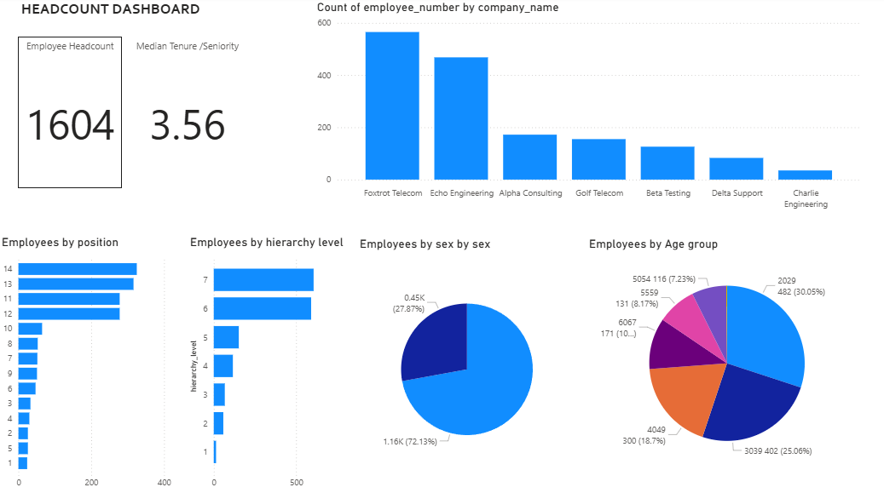
OBJECTIVE 2: Headcount Dashboard

Slide 11
OBJECTIVE 2:
KEY TAKEAWAYS FROM THE HEADCOUNT DASHBOARD
Employee distribution is bottom-heavy, with the majority in entry-level positions (Level 7 and 6). Very few are at senior leadership (Level 1), suggesting a wide base and narrow top—typical of a growing or operationally heavy organization.
The organization has a young workforce, with over 55% under the age of 40. This could contribute to energy and innovation but may also require stronger leadership development and mentoring.
There is a significant gender imbalance, with 72% male and 28% female employees. This may highlight an opportunity for gender diversity initiatives, especially in recruitment and leadership development.
Median tenure indicates moderate retention. While this is healthy, efforts to improve long-term engagement and career pathing could strengthen organizational knowledge and reduce turnover.

Slide 12
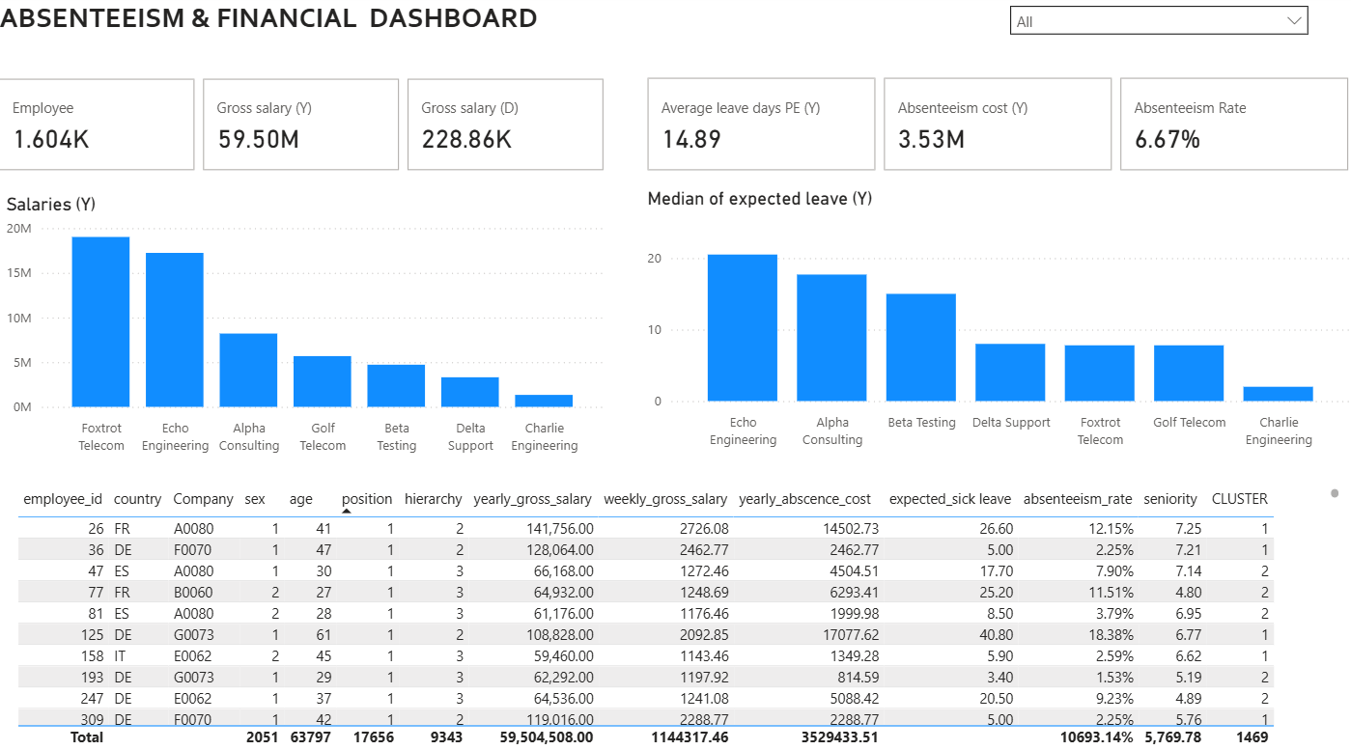
OBJECTIVE 2: Absenteeism Dashboard

Slide 13
OBJECTIVE 2:
KEY TAKEAWAYS FROM THE ABSENTEEISM DASHBOARD
2 companies account for over 60% of total salary expenses, making them key financial centers.
Nearly 6% of payroll value is lost to absence-related downtime (Payroll – absence cost)
Echo Engineering & Alpha consulting might need targeted attention due to hight expected leave —possibly from a workplace wellness, engagement, or operational workflow perspective.
Small reductions can yield significant savings.

Slide 14
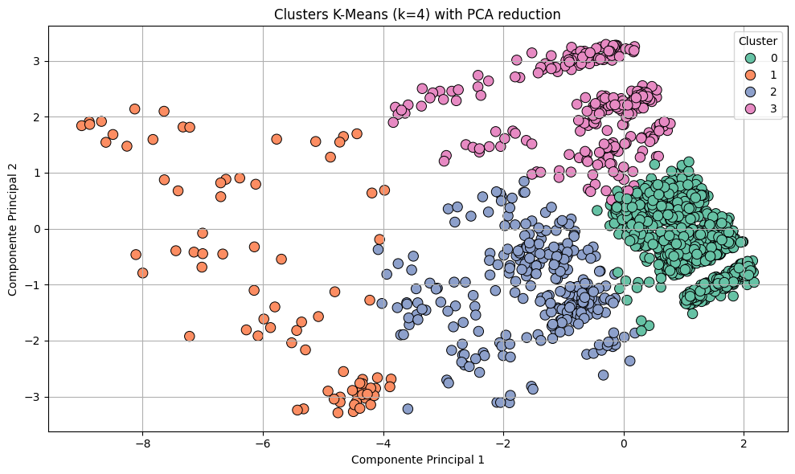
OBJECTIVE 3: Data analysis & Clustering

Slide 15
Employee Cluster definition
We have used Python as a tool to do a K-means clustering analysis, which is a method aims to partition n observations into k clusters in which each observation belongs to the cluster with the nearest mean. Frequently used in machine learning (unsupervised).
CLUSTER 0: Main Workforce
Biggest cluster (60%)
Lowest salary cost
Absenteeism close to healthy levels
Lower salary limits the economical implications of absenteeism
Cluster 1: C-Level
4% of the workforce
They represent 18% of the abscence leave cost
High impact and high financial risk ..
CLUSTER 2: Specialists
Middle management and specialists
Relatively efficcient (low impact
Between cluster 0
CLUSTER 3: Senior workforce
Senior employees with low hierarchical position
Lower salary, extremely high absence.
High economic impact

Slide 16
Employee clusters in numbers
 | Cluster 0 | Cluster 1 | Cluster 2 | Cluster 3
Number of employees | 967 | 80 | 282 | 275
% employee | 60.29% | 4.99% | 17.58% | 17.14%
Average age | 34.1 años | 49.6 años | 38.7 años | 58.1 años
Hierarchical Level | 6 - 7 | 1 - 2 | 4 - 5 | 6
Salary | EUR 2,384.00 | EUR 9,528.00 | EUR 4,144.00 | EUR 2,626.00
Expected leave | 10.2 | 21.2 | 12.4 | 31.9
Absenteeism rate | 3.58% | 8,15% | 5.34% | 13.21%
Cost per employee | EUR 1,130.00 | EUR 8,791.00 | EUR 2,367.00 | EUR 3,878.00
Total cost | EUR 1,092,710.00 | EUR 703,280.00 | EUR 667,494.00 | EUR 1,066,450.00

Slide 17
OBJECTIVE 4: Wellbeing options
To tackle absenteeism, we will consider 3 different products– A well being app (early detection) and supporting employee mental health trough psychology sessions.
WELLBEING APP: 3 € per user per month and one-off cost of deployment (20K)
2 sessions per month: 100 euros per user per month
4 sessions per month: 200 per user per month
According to the medical research conducted on partnership with Oxford University, the use during a year of well being app is expected to reduce by 5% the absenteeism rate and the psychology sessions during a year between 20% and 30%

Slide 18
OBJECTIVE 4: Wellbeing proposal
To tackle absenteeism, we are proposing the combination of products applied to different employee clusters.
PROPOSAL
Wellbeing app targeting clusters 0, 2 and 3
Looking for volume to achieve savings and justify the one - off
2 sessions per month: 100 euros per user per month
Critical cluster (Management) with high impact – looking for targeted solutions
ABSCENSE COST | WELLBEING INITIATIVE COST | YEARLY SAVINGS | NET SAVINGS
3,529,433.51 € | 170,864.00 € | 280,646.51 € | 3%*
* Also impacting on employee loyalty/retention and company reputation

Slide 19
WHAT IS COMING NEXT?
INTEGRATE RECRUITMENT & TALENT DASHBOARD AND KPI’S
1
MONITORING OF KPI’S AND REVIEW ACCORDING TO BUSINESS NEEDS
3
IMPLEMENTATION OF THE PROPOSED WELLBEING INITIATIVES
4
IMPLEMENT DATA INPUT TO ALLOW REAL-TIME KPI MONITORING
2

Slide 20

Thank you

